Slide 1

Where Neural Machine Translation and Translation Memories Meet
Domain Adaptation for the Translation of HKSAR Government Press Releases
SIU Sai Cheong
The work described in this presentation was substantially supported by a grant from the Research Grants Council of the Hong Kong Special Administrative Region, China (Project No. UGC/FDS14/H16/18).

Slide 2
Outline
1. An Overview of HKSAR Government Press Releases
2. Machine Translation of Government Press Releases
3. Our Approach: Translation Memory + Machine Translation
4. Our Experiments
5. The Way Forward

Slide 3
1. An Overview of HKSAR Government Press Releases

Slide 4
Hong Kong Government Press Releases
An important communication channel between the government and the public
Information provided by different bureaus and departments

Slide 5
HKSAR Government Press Releases
Available online: https://www.info.gov.hk/gia/general/today.htm
Three versions: English, Traditional Chinese, and Simplified Chinese

Slide 6
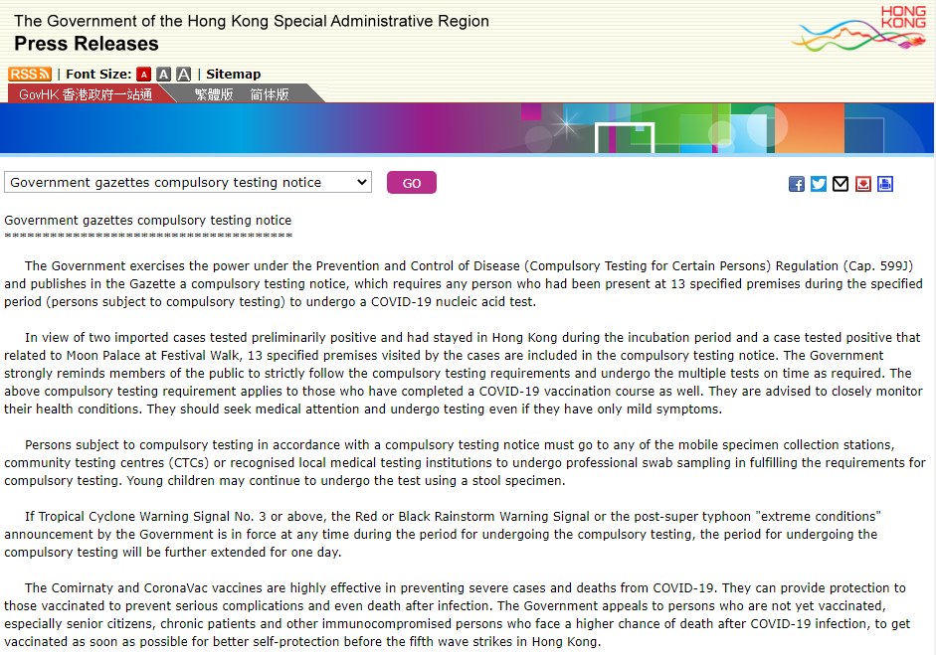
(Source: https://www.info.gov.hk/gia/general/202201/02/P2022010200040.htm)

Slide 7

(Source: https://www.info.gov.hk/gia/general/202201/02/P2022010200039.htm)

Slide 8
Examples
Announcements
Statements
Speeches
Event promotional materials

Slide 9
Themes
Immigration
Labour
Urban Planning
Finance
Law and Order
Housing and Land
Recreation
Public Health

Slide 10
Bilingual Press Releases
English: 4 million tokens/year
Chinese: 6 million characters/year
(Based on the bilingual press releases (2016-2018) collected automatically)

Slide 11
2. Machine Translation of Government Press Releases

Slide 12
Machine Translation of Government Press Releases
Neural Machine Translation (NMT)
Use of deep artificial neural networks
Performance
Popularity

Slide 13

Issues
Word Choices
Sentence Structure
Terminology
Proper Nouns
Formatting
Writing Style

Slide 14

Domain Adaptation: General MT→ Specialized MT?

Slide 15
3. Our Approach: TM + MT

Slide 16



General MT
General data
How?
Domain-specific data

Slide 17
How can we make use of this?
Domain-specific data

Slide 18



Training from scratch
General data
Domain-specific data
Specialized MT
Further Training
General MT
Domain-specific data

Slide 19



(Re-)raining needs

Slide 20

Is it possible to get rid of model (re-)training?
General MT
Domain-specific data

Slide 21
A Common Approach
We can use domain-specific data.
However, this often requires re-training or additional training of the model.

Slide 22


Our Approach
Translation Memory
Machine Translation
Designed for MT (rather than HT)
Containing phrases and sentences
Facilitating the translation of domain-specific content
No re-training or additional training of the model

Slide 23
Our Approach: A Closer Look
Source Text
1. Pre-translation
Source Text
(with placeholders)
2. Machine Translation
Target Text
(with placeholders)
3. Post- Translation
Target Text
The red flag has been hoisted at Silverstrand Beach in Sai Kung District.
The red flag has been hoisted at <0> in <1> District.
<1>區的<0>已懸掛紅旗。
西貢區的銀線灣泳灘
已懸掛紅旗。

Slide 24
Our Sample TM
Bilingual government press releases (2016-2018)
408,000 sentence pairs (after automatic alignment)
270,000 translation units (after removal of segments with low interlingual similarity)

Slide 25
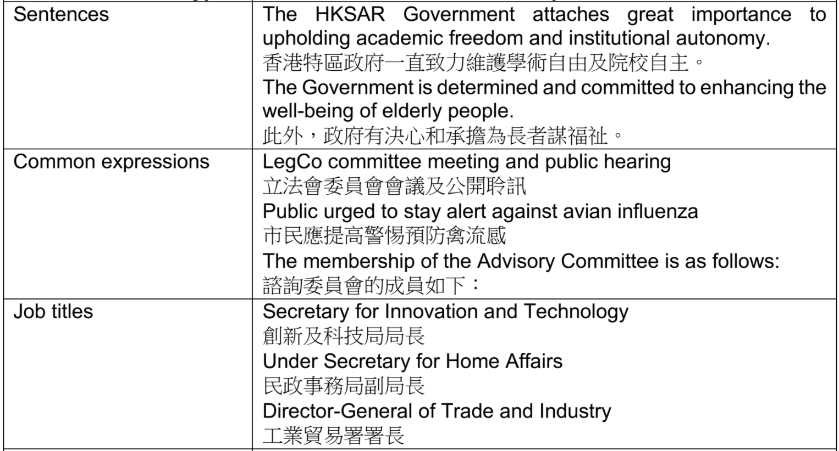
TM Examples

Slide 26
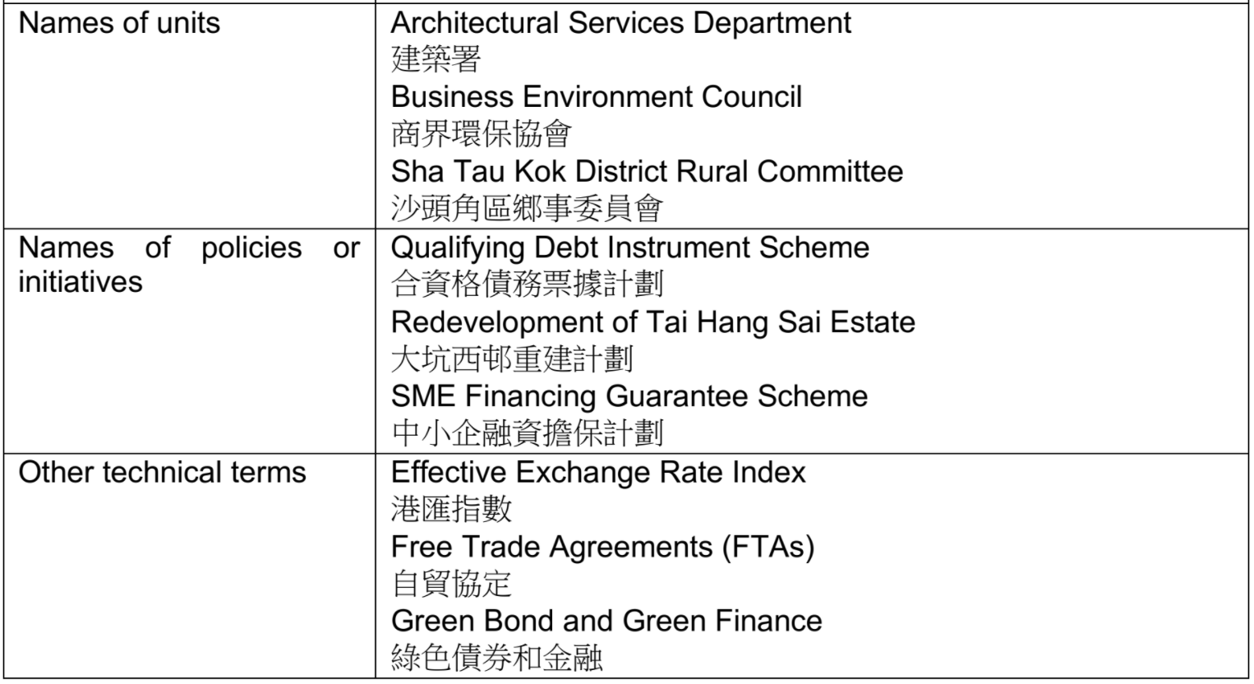
TM Examples

Slide 27
4. Our Experiments

Slide 28
Experiments
Experiment 1: A Popular Online Engine
Experiments 2 and 3: Our Own NMT Models

Slide 29
Experiment 1
Online MT
TM
Online MT
VS

Slide 30
Our Test Dataset
Press releases in January 2019
5,000 bilingual sentences
156,473 English tokens and 130,646 Chinese tokens

Slide 31
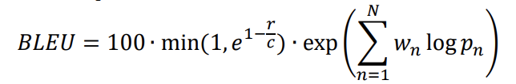
Experiment 1: Results
 | Google Translate without pre-translation | Google Translate with pre-translation | BLEU difference after pre-translation
BLEU score based on the test set (BLEU4) | 23.73 | 35.51 | +11.78

Slide 32
Example 1
Source Text: Investigation by the Special Investigation Team of Traffic, Kowloon East is underway.
Reference Translation: 東九龍總區交通部特別調查隊正跟進調查該宗意外。
Output 1 (without pre-translation): 九龍東交通特別調查組正進行調查。
Output 2 (with pre-translation): 東九龍總區交通部特別調查隊正跟進調查案件。

Slide 33
Example 2
Source Text: His nasopharyngeal aspirate tested positive for influenza A virus upon laboratory testing.
Reference Translation: 他的鼻咽分泌樣本經化驗後，證實對甲型流感病毒呈陽性反應。
Output 1 (without pre-translation): 他的鼻咽部抽吸物經實驗室檢測呈甲型流感病毒陽性。
Output 2 (with pre-translation): 病人的鼻咽分泌樣本經化驗後，證實對甲型流感病毒呈陽性反應。

Slide 34
Example 3
Source Text: Admission to the ward has been suspended and restricted visiting has been imposed.
Reference Translation: 該病房已暫停接收新症,並實施有限度探訪安排。
Output 1 (without pre-translation): 該病房已暫停入場，並已實施限制探視。
Output 2 (with pre-translation): 有關病房已暫停接收新症，並實施有限度探訪安排。

Slide 35
Experiment 2
Bidirectional LSTM
Bidirectional LSTM
Bidirectional LSTM
Model 1
Model 2
Model 3
General documents
General documents +
Government documents
General documents +
Government documents +
Government Press Releases
With/out TM

Slide 36
Model Architecture
Similar to other recurrent neural networks for translation (Sutskever, Vinyals & Le (2014), Bahdanau, Cho & Bengio (2014), Luong, Pham & Manning (2015), and Y. Wu et al. (2016)), the three models adopt the bi-directional long short-term memory (LSTM) architecture (Hochreiter & Schmidhuber, 1997) comprising the encoder and decoder (4 layers each) with the attention mechanism.

Slide 37







Our Bidirectional LSTM Model
Encoder
Source Text Embeddings
Bidirectional LSTM
Bidirectional LSTM
Bidirectional LSTM
Bidirectional LSTM
Attention
Decoder
Target Text Embeddings
LSTM
LSTM
LSTM
LSTM
Softmax
TL Token

Slide 38
Experiment 2: Results
 | BLEU score of model without pre-translation | BLEU score of model with pre-translation | BLEU difference after pre-translation
Model 1 | 15.56 | 29.28 | +13.72
Model 2 | 18.09 | 31.23 | +13.14
Model 3 | 38.75 | 44.71 | +5.96

Slide 39
Experiment 3
The recent popularity of using the Transformer model (Vaswani et al., 2017) (or its variants) for not only machine translation but also other natural language processing applications (e.g., Devlin et al., 2019) and even image processing (Dosovitskiy et al., 2020) suggests that it would be worthwhile to assess the applicability of our method to NMT engines adopting the self-attention architecture.

Slide 40
Experiment 3
Transformer
Transformer
Transformer
Model 4
Model 5
Model 6
General documents
General documents +
Government documents
General documents +
Government documents +
Government Press Releases
With/out TM

Slide 41
Model Architecture
The configuration of each of the models follows the base WMT Transformer model proposed by Vaswani et al. (2017), with a 6-layer encoder, a 6-layer decoder, 512-dimensional positional embeddings, and 2048-dimensional position-wise feed-forward networks.

Slide 42
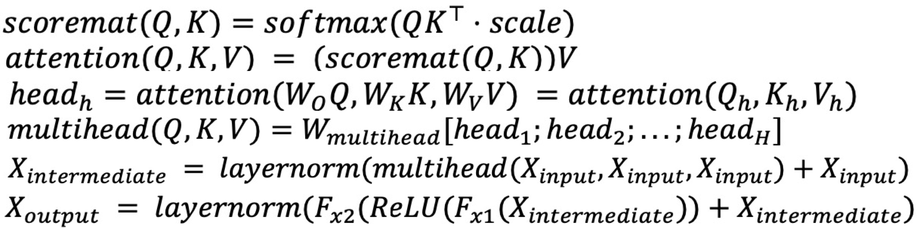
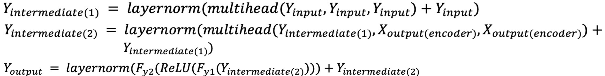
Our Transformer Model
Encoder
x 6
Source Text Embeddings
Multi-head Attention
Residual Connection and Normalization
Feed Forward
Residual Connection and Normalization
Decoder
x 6
Target Text Embeddings
Multi-head Attention
Residual Connection and Normalization
Multi-head Attention
Residual Connection and Normalization
Feed Forward
Residual Connection and Normalization
Linear and Softmax
TL Token

Slide 43
Experiment 3: Results
 | BLEU score for model without pre-translation | BLEU score for model with pre-translation | BLEU difference after pre-translation
Model 4 | 14.40 | 28.28 | +13.88
Model 5 | 18.56 | 30.97 | +12.41
Model 6 | 42.86 | 46.16 | +3.3

Slide 44
5. The Way Forward

Slide 45
Future Research
Design of translation memories for pre-translation
Matching and restoration methods
Ways to represent pre-translated expressions in the source text for MT
Applicability to other NMT models or language pairs

Slide 46
References
Bahdanau, D., Cho, K., & Bengio, Y. (2014). Neural machine translation by jointly learning to align and translate. arXiv preprint arXiv:1409.0473.
Devlin, J., Chang, M. W., Lee, K., & Toutanova, K. (2019, June). BERT: Pre-training of Deep Bidirectional Transformers for Language Understanding. In Proceedings of the 2019 Conference of the North American Chapter of the Association for Computational Linguistics: Human Language Technologies, Volume 1 (Long and Short Papers) (pp. 4171-4186).
Dosovitskiy, A., Beyer, L., Kolesnikov, A., Weissenborn, D., Zhai, X., Unterthiner, T., ... & Houlsby, N. (2020). An image is worth 16x16 words: Transformers for image recognition at scale. arXiv preprint arXiv:2010.11929.
Hochreiter, S., & Schmidhuber, J. (1997). Long short-term memory. Neural computation, 9(8), 1735-1780.

Slide 47
References
Luong, M. T., Pham, H., & Manning, C. D. (2015, September). Effective Approaches to Attention-based Neural Machine Translation. In Proceedings of the 2015 Conference on Empirical Methods in Natural Language Processing (pp. 1412-1421).
Sutskever, I., Vinyals, O., & Le, Q. V. (2014). Sequence to Sequence Learning with Neural Networks. Advances in Neural Information Processing Systems, 27, 3104-3112.
Vaswani, A., Shazeer, N., Parmar, N., Uszkoreit, J., Jones, L., Gomez, A. N., ... & Polosukhin, I. (2017). Attention is all you need. In Advances in neural information processing systems (pp. 5998-6008).
Wu, Y., Schuster, M., Chen, Z., Le, Q. V., Norouzi, M., Macherey, W., ... & Dean, J. (2016). Google's neural machine translation system: Bridging the gap between human and machine translation. arXiv preprint arXiv:1609.08144.

